Slide 1
Herpes Simplex Virus 1 Amplicon Vectors
Kimberly Velarde
Dr. Ian Hogue’s Lab

Slide 2

Herpes Simplex 1 Reactivation in Astronauts
Shedding 1 or MORE Herpes viruses
53% from short duration space shuttle flights
61% from long duration ISS missions
Rooney et. al. 2019

Slide 3
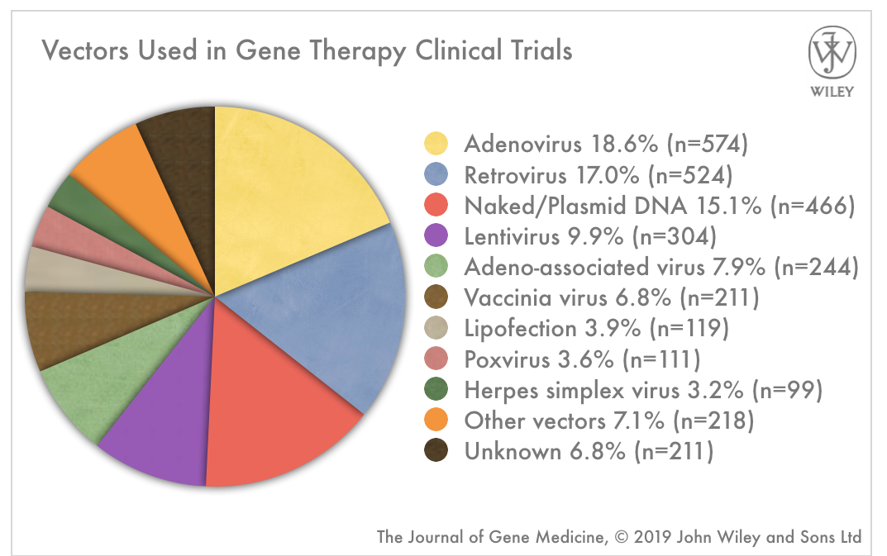

Slide 4

Herpes Simplex Virus 1
~150 kbp
Adeno-associated Virus
~4.8 kbp
Adenovirus
~7.5 kbp
Lentivirus
~9 kbp

Slide 5
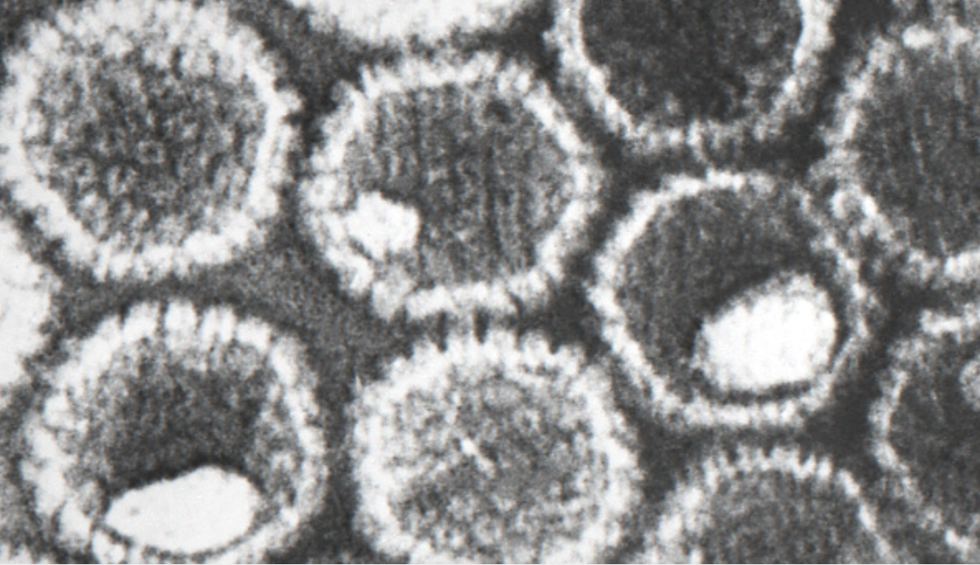
Herpes Simplex Virus I
Affects two-thirds of the population
Over 100 herpesviruses
Notes:
9 known human herpesviruses

Slide 6
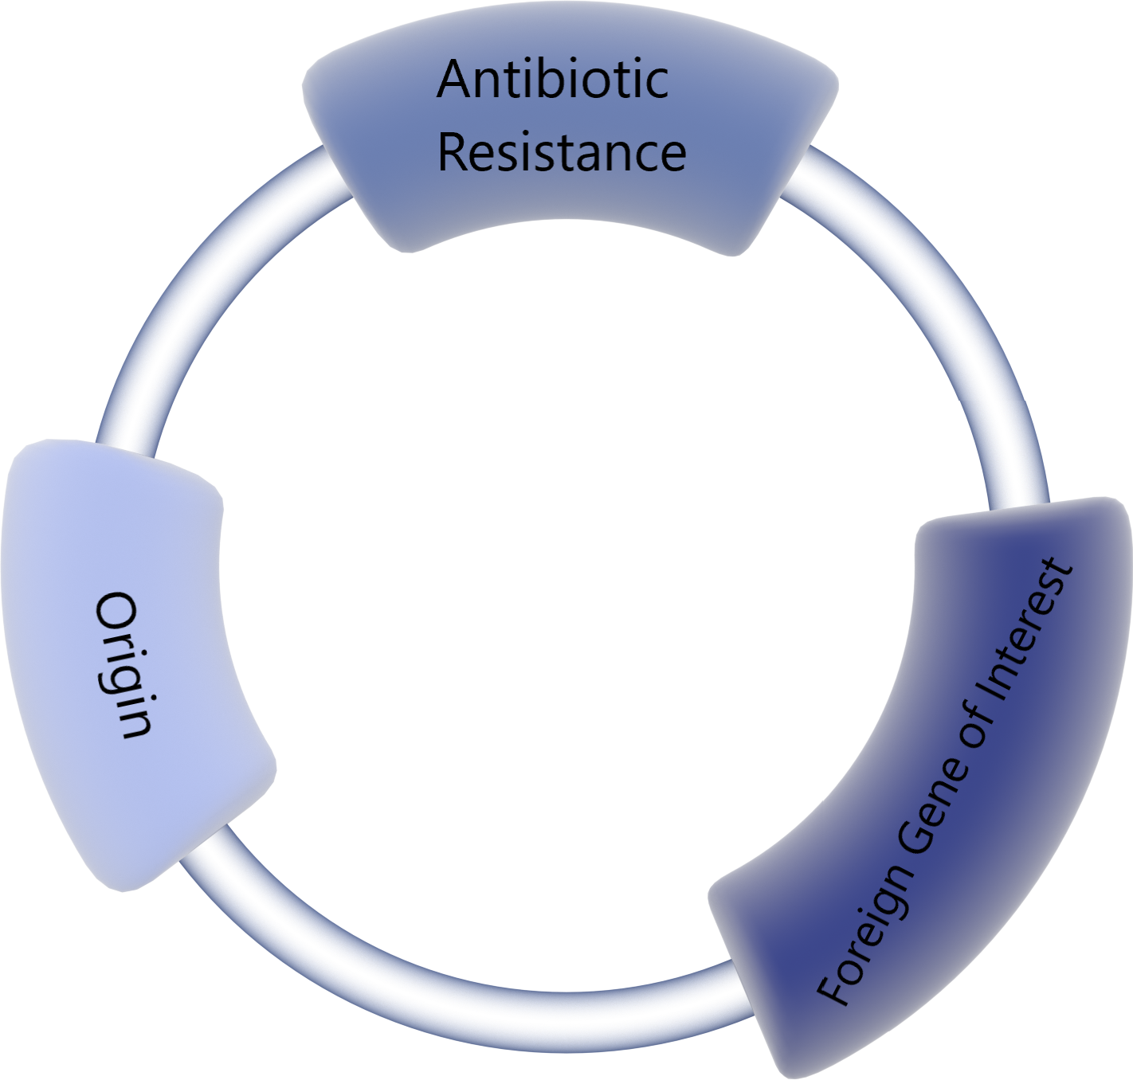
HSV-1 Amplicon Plasmid Vector:
E. Coli origin of replication
HSV-1 origin of replication
HSV-1 packaging signals
Notes:
HSV-1 amplicon vectors are perfect for gene transfer studies as they can infect many cell types, both non-dividing and dividing, have a large transgene capacity and are easy to manipulate.

Slide 7
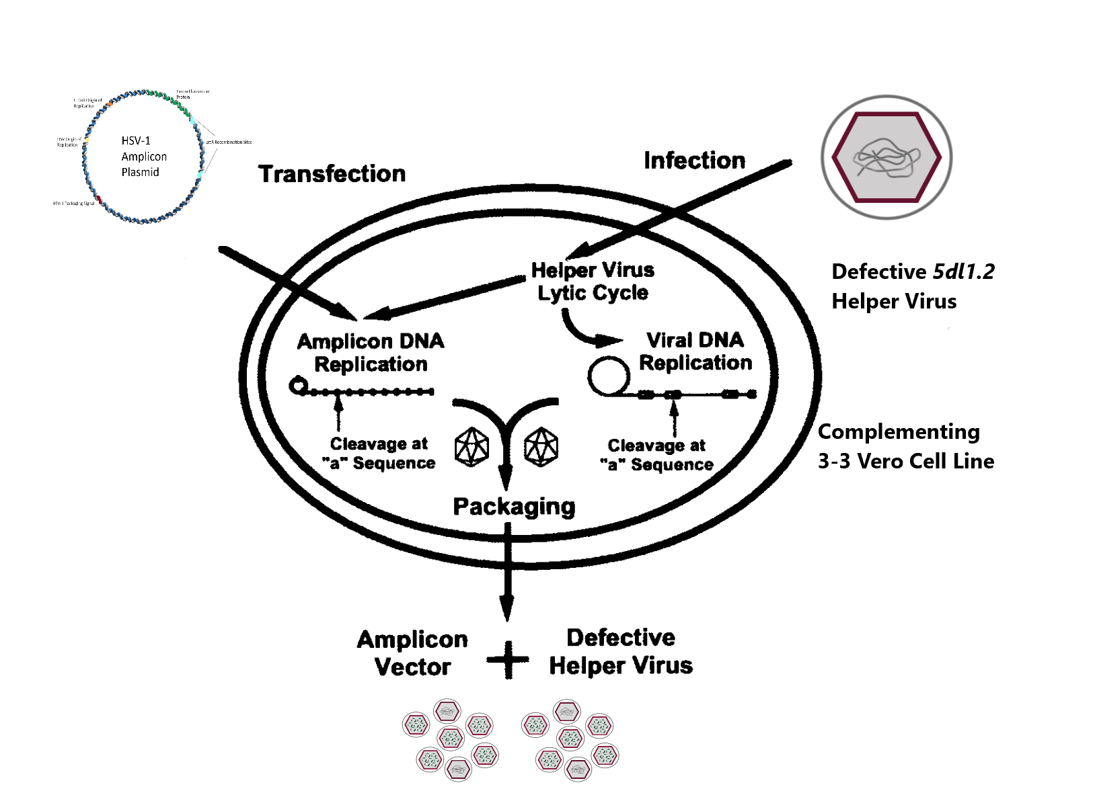
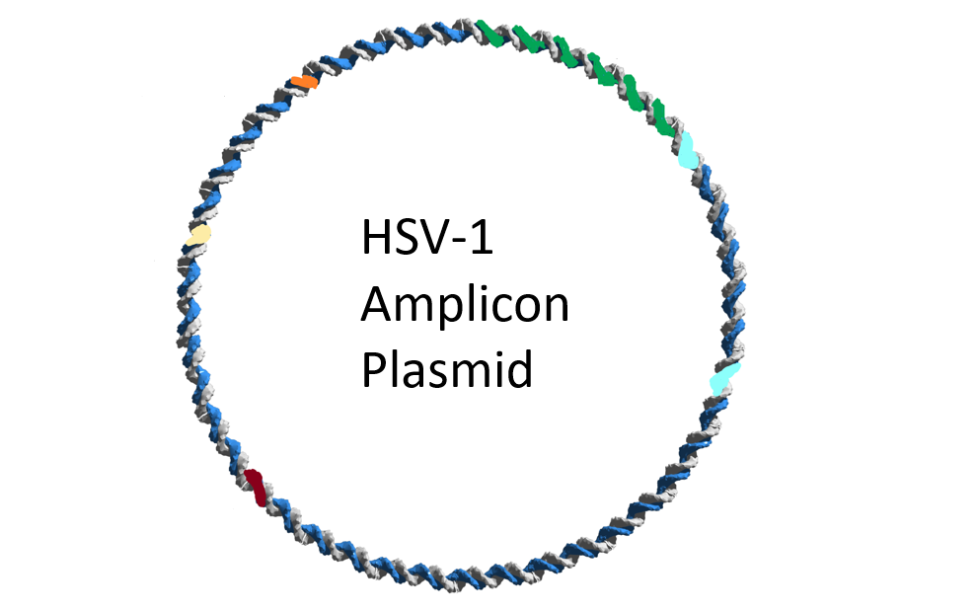
ICP27 deletion mutant 5dl1.2 helper virus
3-3 Vero cells ICP27-expression
Glorioso et. al. 1997
Notes:
ICP27 has been shown to be essential for virus growth

Slide 8
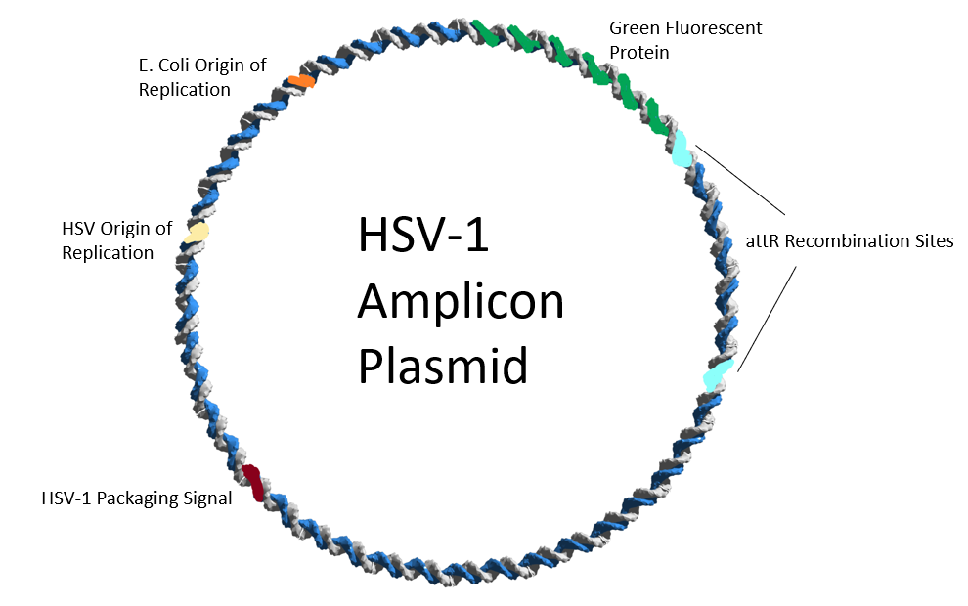
Novel HSV-1 Amplicon Vector System

Slide 9
Hypothesis
Using this novel HSV-1 amplicon vector to demonstrate that the vector stock can subsequently transduce and express GFP in non-complementing cells, I hypothesize that Gateway Recombination will express higher transfection and infection yield compared to previously engineered HSV-1 amplicon vectors.

Slide 10
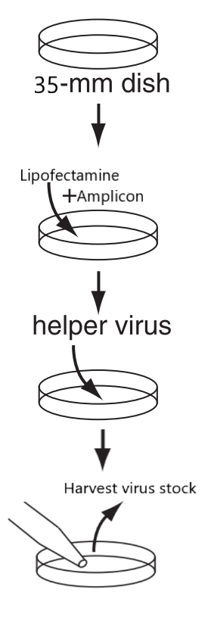
Methods
Transfection
~50% Green Fluorescence
Infection
>50% Green Fluorescence

Slide 11
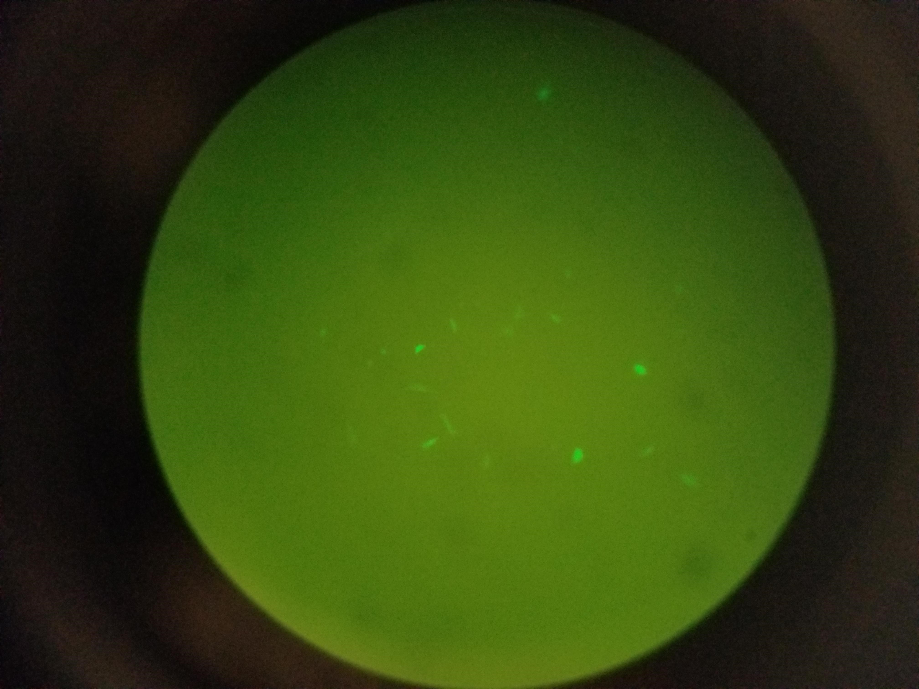
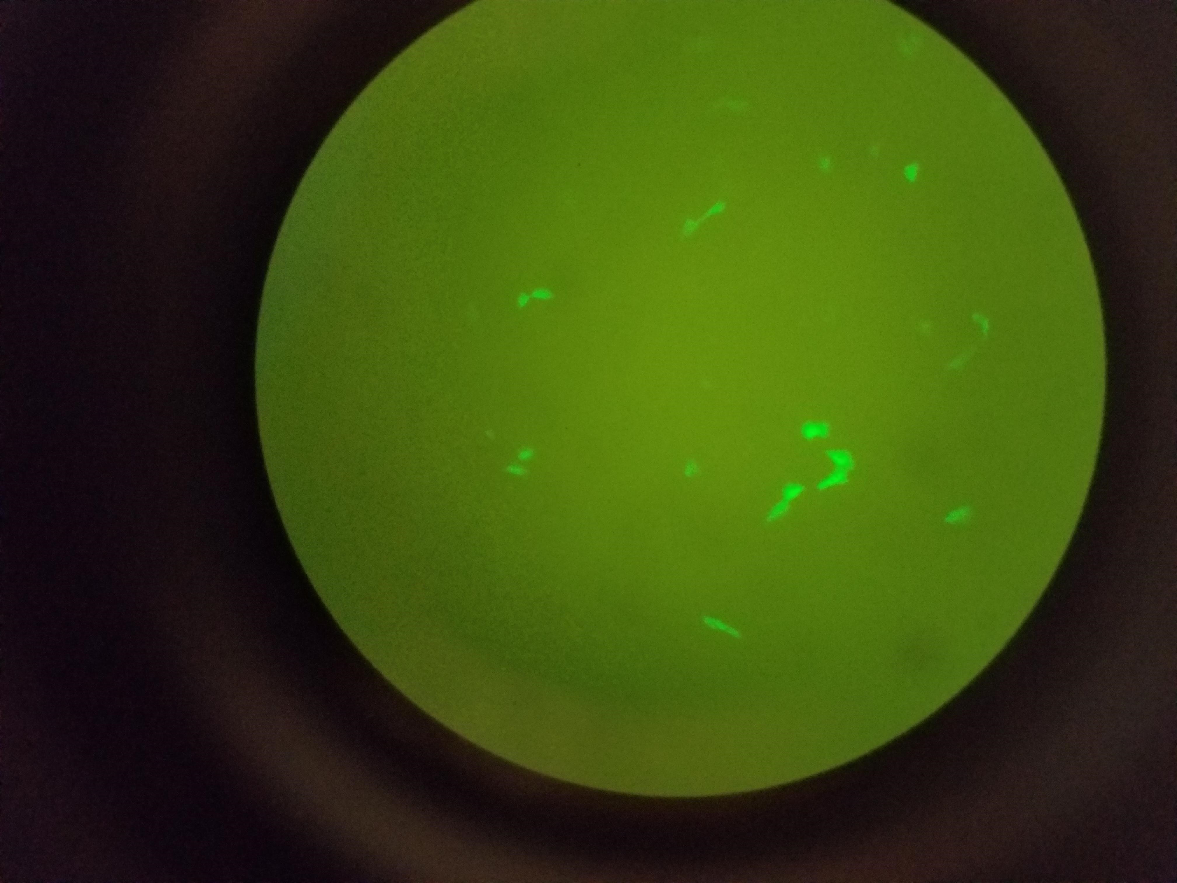
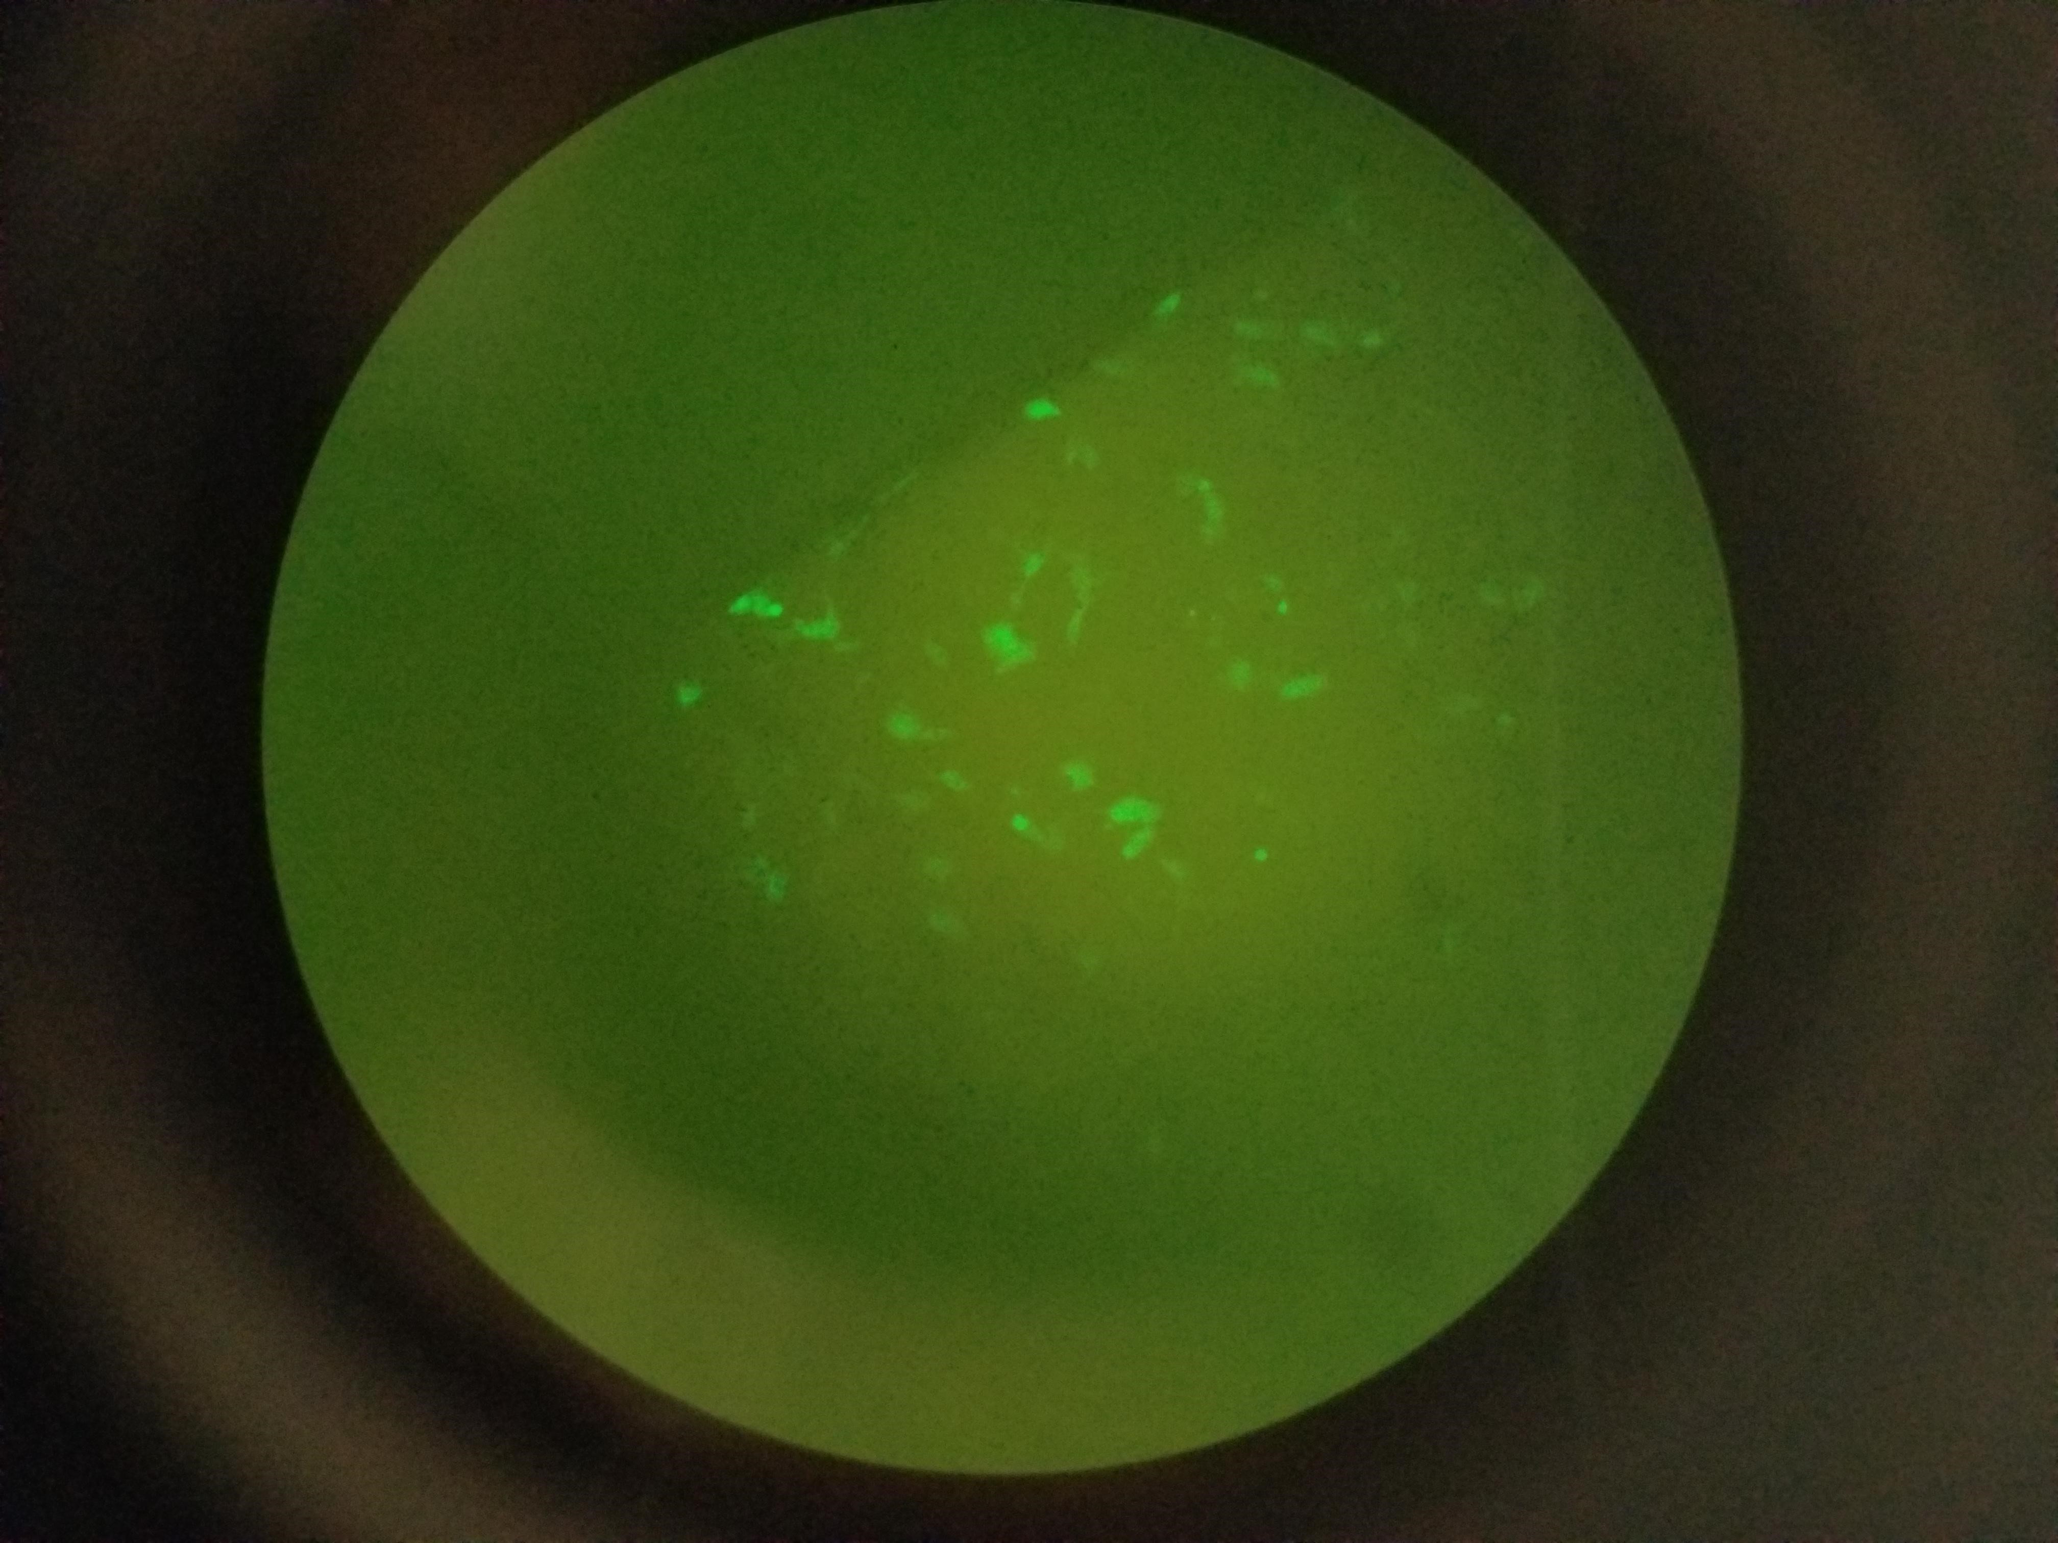
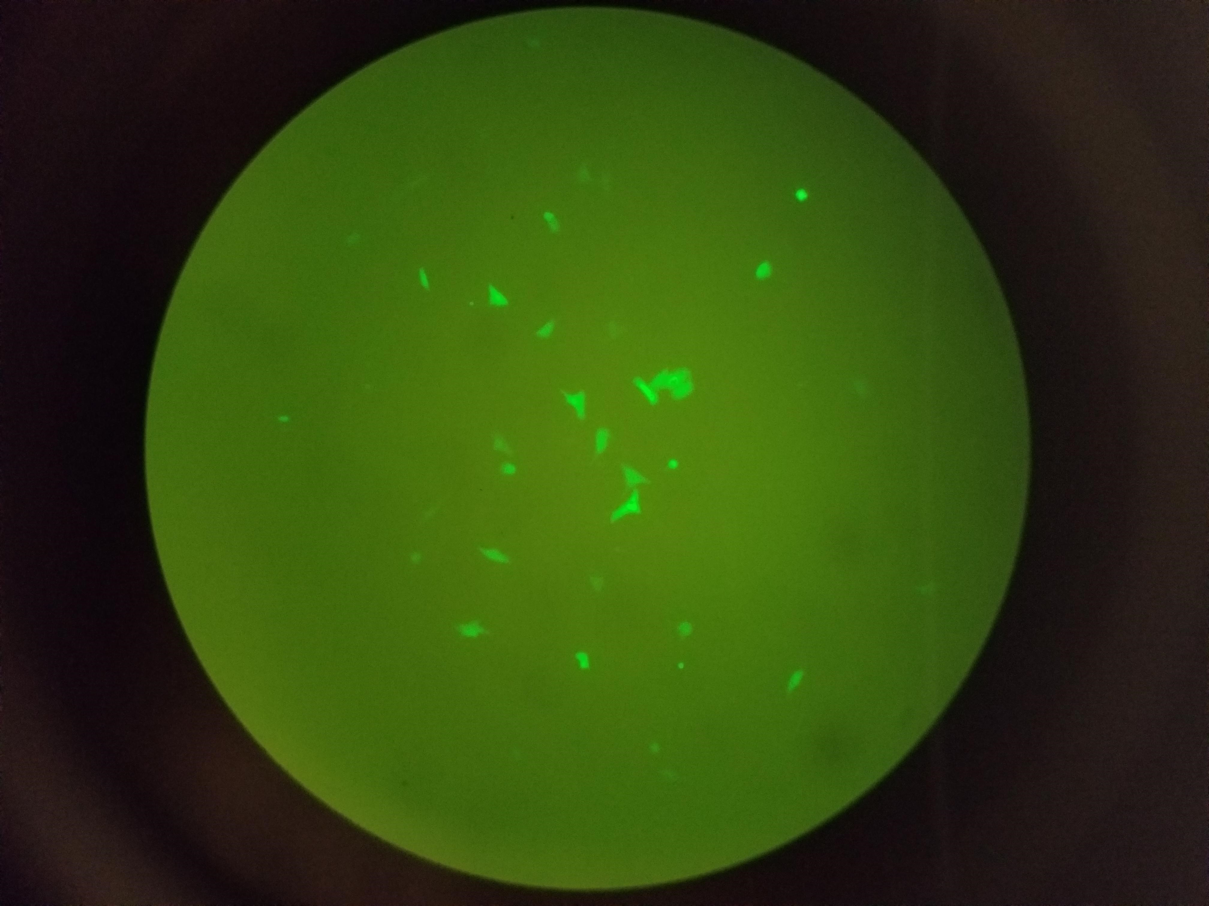
Results
HSV-1-C
HSV-1-N
2µg
3µg

Slide 12

Future Directions
Infecting with helper virus
Optimize and maximize green fluorescent yield
Helper virus and amplicon titer
Attempt using vector and a gene of interest
Notes:
Reference hypothesis.
To further test the hypothesis….

Slide 13

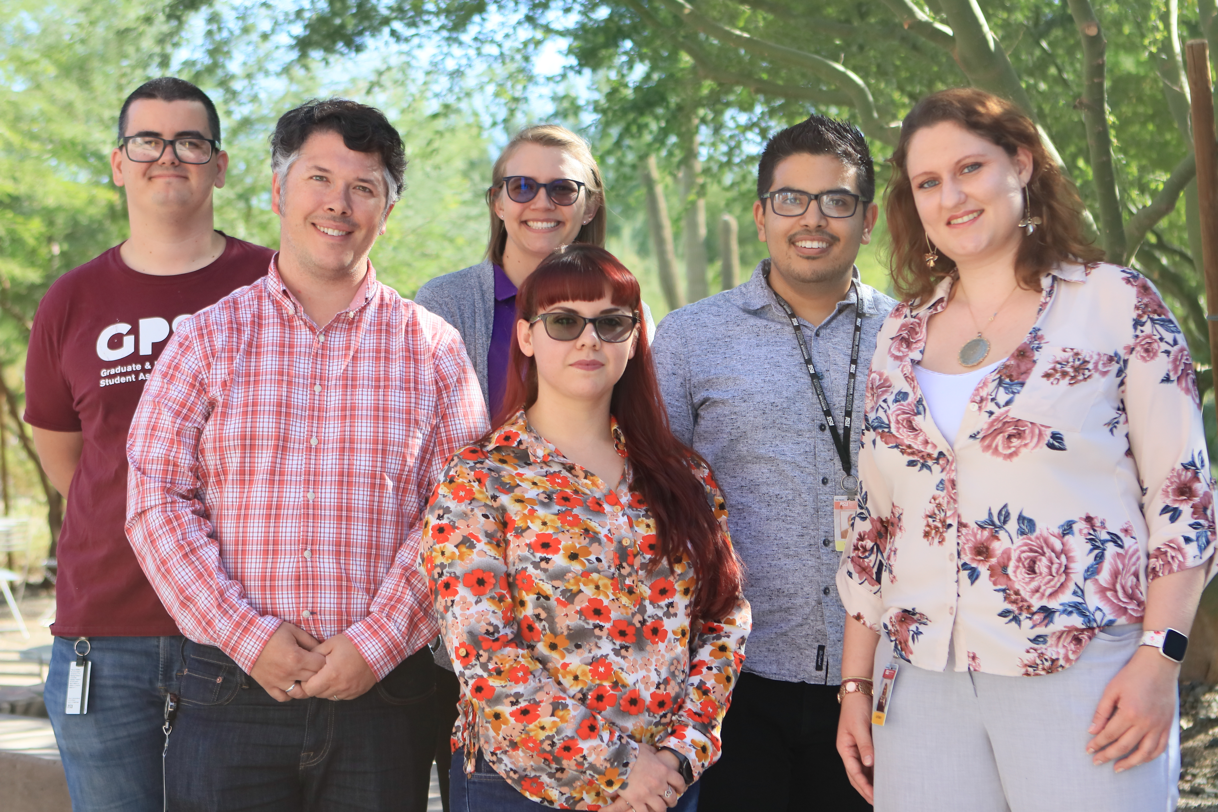


Acknowledgements
Dr. Ian Hogue’s Lab
Joli Bastin
Melissa Bergeman
Wesley Tierney
Ian Vicino
Nicholas Narcy
Kimberly Velarde

Slide 14

Questions?

Slide 15
References
Gene Therapy Clinical Trials Worldwide. 2019. The Journal of Gene Medicine.
Glorioso JC, Goins WF, Fink DJ. 1995. Herpes Simplex Virus as a Gene-Delivery Vector for the Central Nervous System.
Henderson, C. "Radical Vaccine Design Effective against Herpes Viruses." AIDS Weekly (2015): A2, A3, A4. Web.
Neve RL, Neve KA, Nestler EJ, Carlezon WA. 2005. Use of herpes virus amplicon vectors to study brain disorders. Biotechniques 39:381–389.

